Slide 1

Machine Learning Automotive Dealer Price Decision WeCloud Data Scientice Diploma James Zhao

Slide 2
TABLE OF CONTENTS
01
Motivation
02
Business Problem to Solve
03
Data Collection Methods
04
Data Cleaning & Feature Engineering
05
Machine Learning Modelling Algorithms
06
Model Interpretation and Visualizations

Slide 3
01
Motivation
Almost Essential to Life Convenience
Car History
Research
Used Auto
Industry
Industry Market
Growth
Price Decision

Slide 4

02
Business Problems
Lower Price & Less Depreciation
No Extra Fees on Package
More Variety to Choose
Research of Car Brand History
Warranties/Services
Retention
Pollution
Long-time to Consider
Advantages
Disadvantages
Main Question: Determine the capable price of a used vehicle that satisfy both the seller and the purchaser

Slide 5

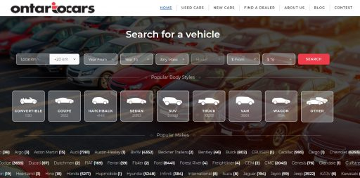

03
Data Collection Methods
Web Scraping
Website:
Ontariocars.ca
Public Website
Operated by: UCDA (Used Cars Dealers Association of Ontario)
Products Include both new and used cars
Tools Used:

Slide 6
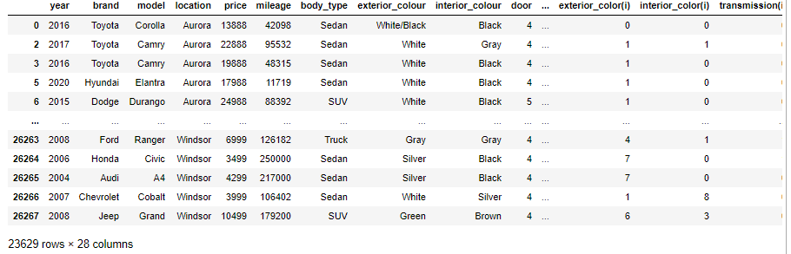
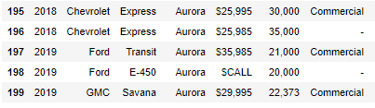
03 Data Collection Method: Web Scraping
Data Frame
Very Messy DataFrame
Important!! Some vehicles have unspecified Prices

Slide 7
04
Data Cleaning and Feature Engineering
Remove redundant signs in price and mileage
Remove redundant characters in feature that only allows integers
Set Vehicle id
Change categorical strings to integers for ML modelling
Group the vehicles brand as country of origin
Based on mileage, determine the real year driven, assume miles driven are fixed each year
Replace or drop null values
Main
Objectives

Slide 8
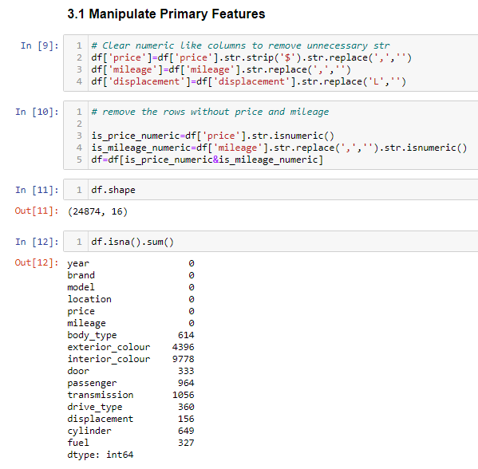
04 Data Cleaning & Feature Engineering
Price and Mileage are the main features, $sign and commas are removed
Some Features has many null values
If remove all, dataset may be too small, consider filling some null values
Almost all features need to be cleaned and adjusted

Slide 9
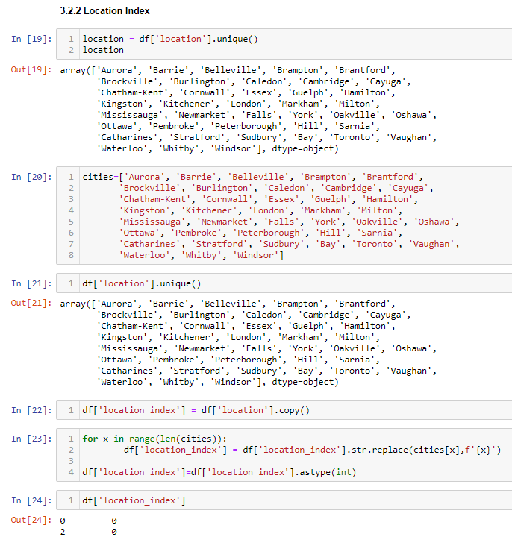
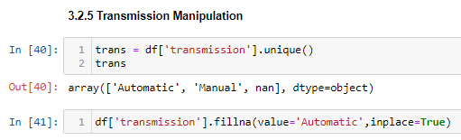
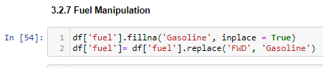
04 Data Cleaning & Feature Engineering
Cleaning Examples:
Assume Automatic Transmission When null
Assume Gasoline Fuel Type When null
All locations are assigned an index, for the purpose of analysis, since location might have effect on price, etc on other features

Slide 10
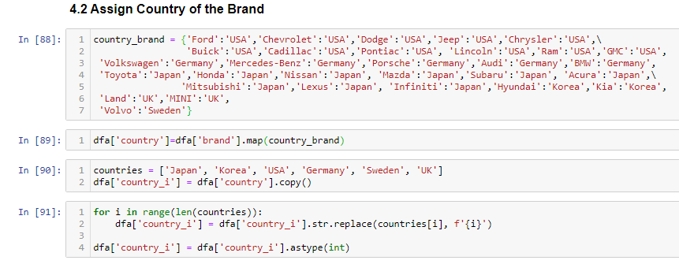
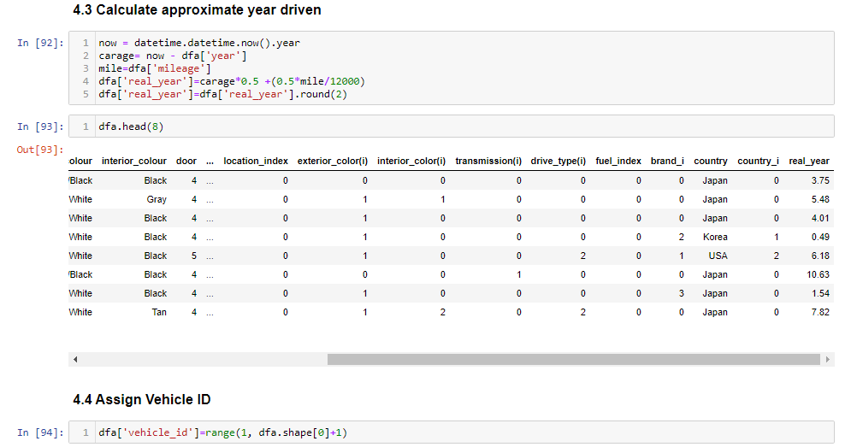
04 Data Cleaning & Feature Engineering
Only Top 28 Vehicles Brands are chosen, all others are too rare in the market.
23629 entries after filtering
Columns(Features) Added:
Country of the Brand
Vehicle id
Real Year (year that the vehicle is driven on road)

Slide 11
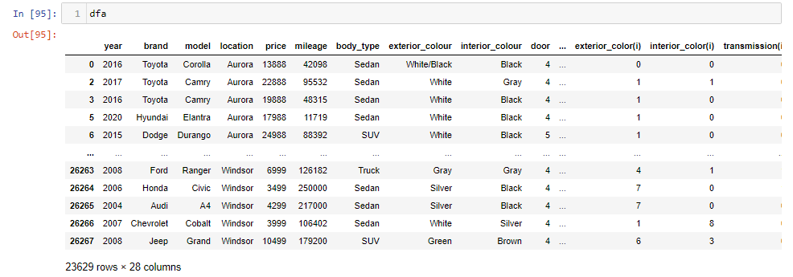
05
Machine Learning Modelling Algorithms
Algorithms Tested
Multiple Linear Regression
Decision Tree Regressor
Random Forest Regressor
Gradient Boost
Ada Boost
XG Boost
Stacking: Linear, Decision Tree, Random Forest
Stacking: Linear, XG Boost, Gradient Boost

Slide 12
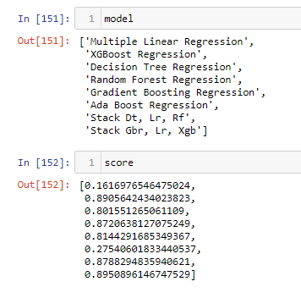
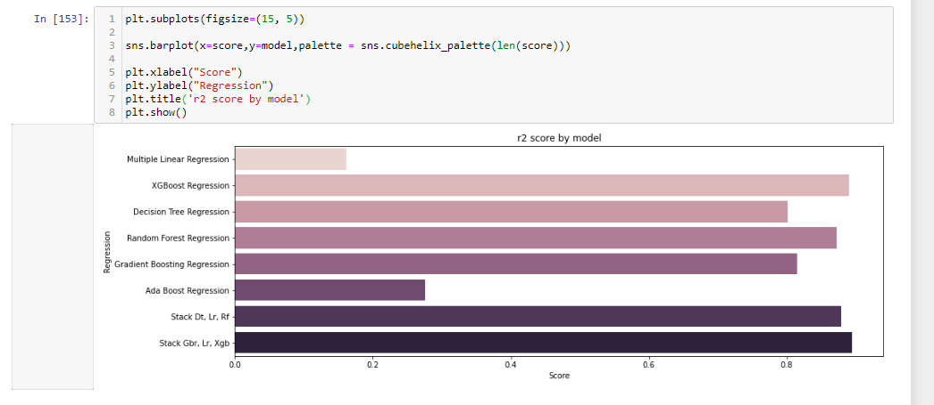
05 Machine Learning Modelling Algorithms
The Chosen Algorithm is Stacking Regressor: Linear Regression, Decision Tree Regressor and Random Forest Regression
R2 score is 0.88

Slide 13
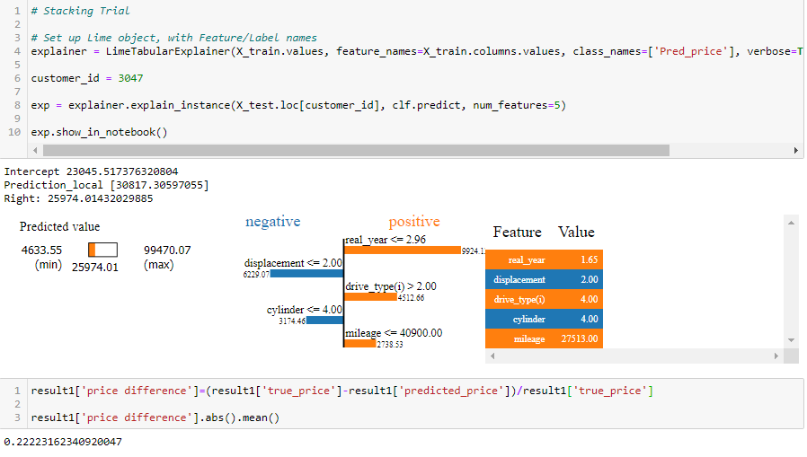
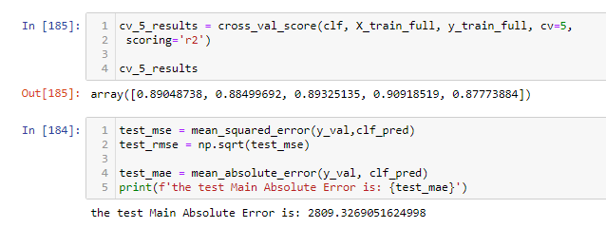
05 Machine Learning Modelling Algorithms

Slide 14
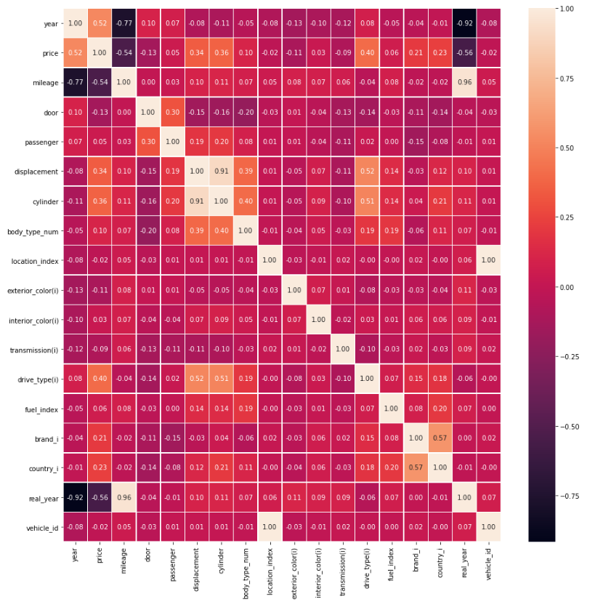

06
Model Interpretation & Visualizations
Tasks
Check how well the model is on predicting price
List the predicting price based on the model
The chosen algorithm is stacking
Compare the original and predicted price
Visualize the model in tableau

Slide 15
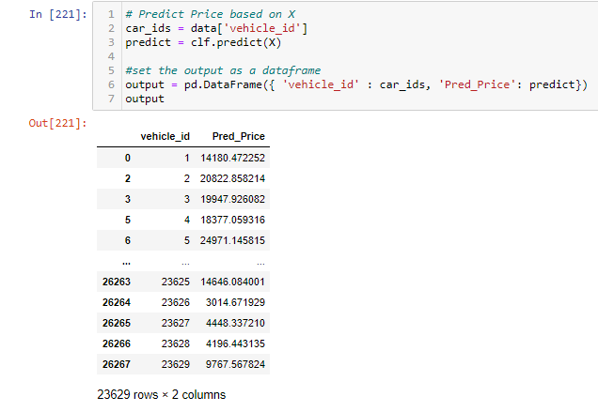
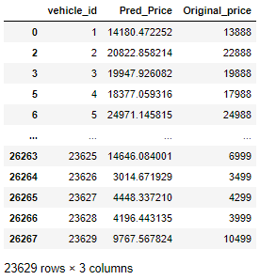
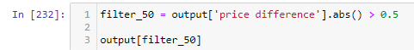
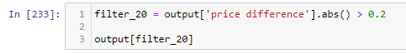
06 Model Interpretation & Visualizations
Use Stacking Regressor that includes:
Linear Regression
Decision Tree Regressor
Random Forest
Predict Price Compare to Original Price
(Original Price – Predict Price)/Original Price
Absolute value all and calculate mean
The percentage difference mean is the lowest in this algorithm
Most of the Predictions are pretty good, about 90% of the data are within 20% price fluctuation
Over 50% difference, 345 Outliers
Over 20% difference, 2505 Entries

Slide 16
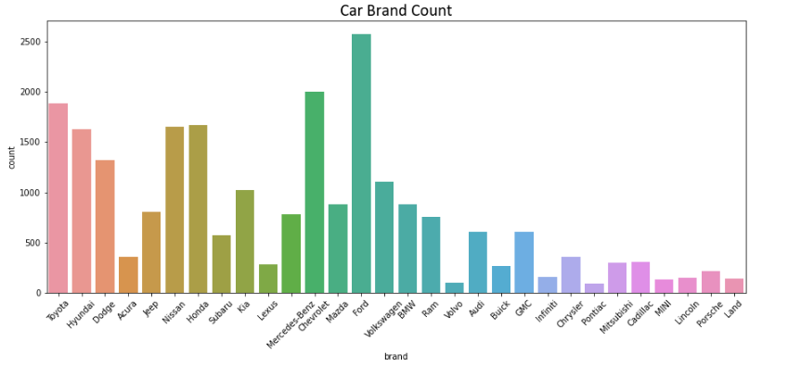
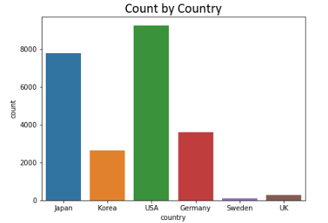
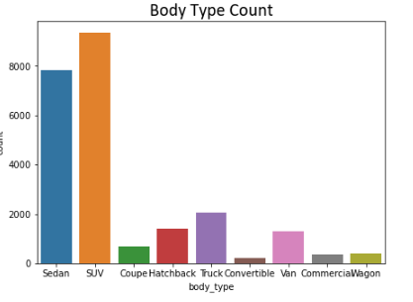
06 Model Interpretation & Visualizations
Top 28 popular Brands of vehicles in Stock
Country of Vehicle Origin Countmap
Country of Vehicle Origin Countmap
Simple Visualizations:
Examples of Count-maps

Slide 17
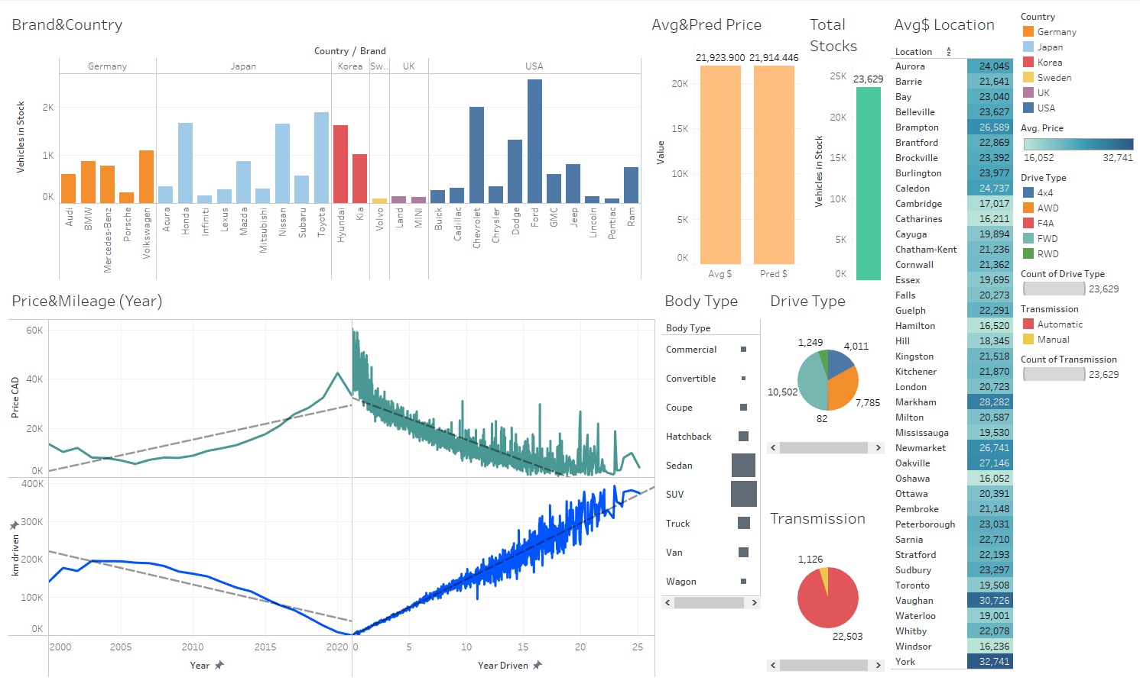
06 Model Interpretation & Visualizations
Tableau
Visualization
Dashboard

Slide 18

Challeges
Fill nulls and drop nulls, most of the fillna are based on logical assumptions, so it’s effect might not be totally accurate to the model. Model performance are affected as well
Still need more features, Text processing not done
Grid Search, hyperparameter tunings have some technical problems, not sure if it is sckit learn’s version problem, taking a long-time for conda to update
Dataset has the potential to contain larger number of entries, need to come up an idea how to scrape data after the 1000th entry of a category (404 error after 1000th entry)
Mean Absolute error is a bit high

Slide 19
THANK YOU

